Slide 1
Azure
Infrastructure as a Service
Shivanshu Upadhyay
Cloud Solutions Architect
Notes:
Talk a bit about your love affair with the cloud starting in your corporate IT role. Needing to have boxes and how much fun it is to meet in the intersection of great developer experience and rock solid reliability

Slide 2

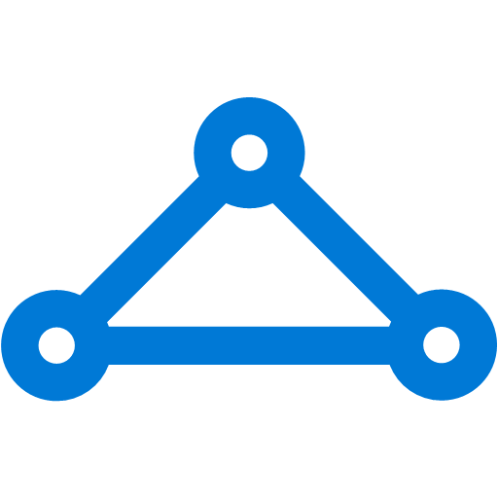
Momentum
120,000
New Azure customer subscriptions/month
100 Trillion
Objects in Azure Storage
>85%
of Fortune 500 use Microsoft Cloud
1 in 3
Virtual Machines run Linux
Connectivity
ExpressRoute Partners on every continent except Antarctica!
UNDER NDA ONLY
Notes:
Azure’s momentum is outstanding and accelerating
Over 85% of the fortune 500 are using the Microsoft Cloud in some way or another
With Azure alone, over 120,000 new subscriptions are created every month
We’re growing on all fronts – over 100 TRILLION objects are in Azure storage, open source workloads are growing with 1 in 3 VMs running Linux.
Azure has ExpressRoute partners on every continent except Antarctica – enabling enterprise connectivity across the globe

Slide 3

Compute families
A
D
F
G
Entry Level
General Purpose VMs
Compute
Optimized VMs
Large Memory VMs
>80,000 IOPs
Premium Storage
Dev/Test and entry-level workloads
Earliest generation, HDD
100 ACU/core
Good combination of memory, SSD for most common production applications
Memory-intensive variants
210 ACU/core
Compute-intensive apps like Gaming, Analytics
More CPU to memory ratio.
210 ACU/core
Large VMs for large databases requiring fast Storage
Intel Haswell processor with 0.5TB RAM
180 ACU/core
Azure Compute Unit (ACU) provides a way of comparing compute (CPU) performance across Azure SKUs.
Notes:
Azure offers a broad set of compute family that customers can take advantage from dev test to large database workloads

Slide 4
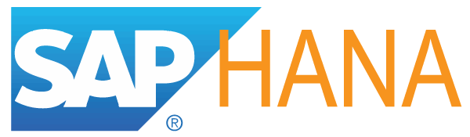
New compute size options
Nov 16
OCT 16
CY17 H1
Nov 16
SEPT 16
CY17 H1
SEPT 16
A
Av2
D
F
L
S
G
N
H
Z
Av2
Av2
A
D
Dv2
F
G
Av2
Av2
Optimized for small production and dev/test workloads
Optimized for No-SQL, Databases
Optimized for big data Hadoop workloads
Optimized for GPU accelerated workloads
Optimized for CPU intensive workloads
Optimized for largest enterprise applications
Optimized for large SAP HANA workloads
HIGHEST VALUE
LARGEST SCALE-UP
More than doubling the compute offerings in 2016
UNDER NDA ONLY
Notes:
Key talking points:
There are several new instance sizes that will be introduced over the next 6 months.
Each of these instance sizes are designed for increased performance and flexibility with capabilities tailored to specific workloads

Slide 5
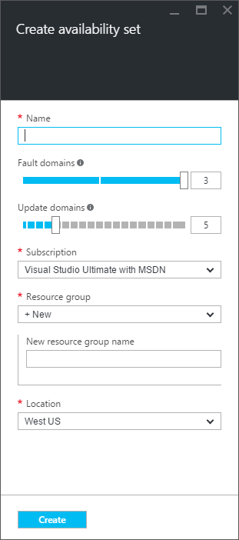
Availability Set
Fault domains - fault domains define the group of virtual machines that share a common power source and network switch. By default, the VMs are separated across up to three fault domains and can be changed to between 1 and 3.
Update domains - five update domains are assigned by default and this can be set to between 1 and 20. Update domains indicate groups of virtual machines and underlying physical hardware that can be rebooted at the same time.

Slide 6
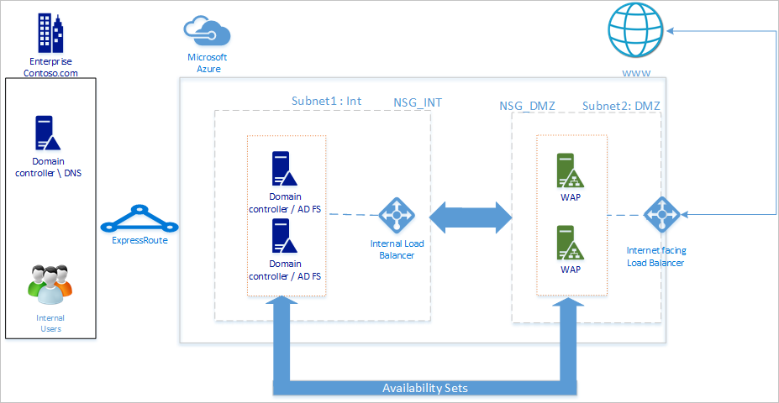
Highly Available ADFS in Azure

Slide 7
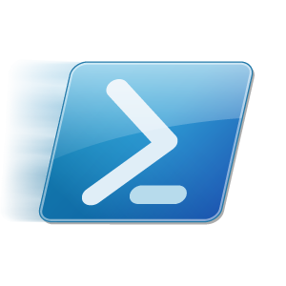


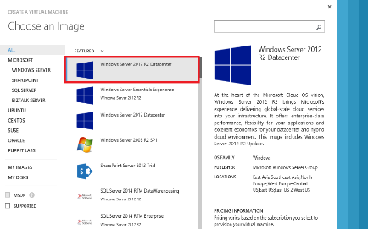
VM Extensions
Extending the power of your VM.
Enable easier management.
Support partner ecosystem.
Full control remains with you!
IaaS extended
Curated extensions
Agent
Azure

Slide 8
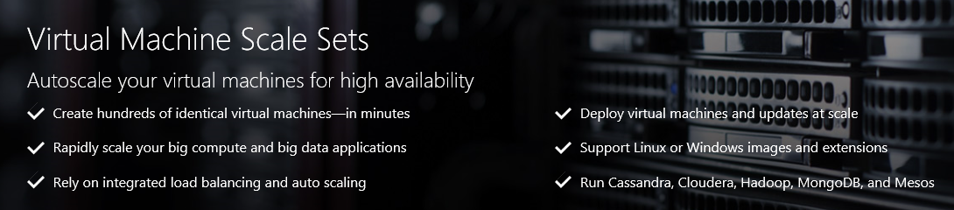
Virtual Machine Scale Sets
Deploy and manage VMs as a set
A scalable, platform-independent infrastructure for PaaS
Notes:
Put simply scale sets are a Compute resource which let you manage VMs as a set – a deployment orchestrator.
- Provide features required by modern cloud apps.
- Infrastructure for PaaS - Make it easier to create your own platform services.

Slide 9
DevTest Labs
Controlled environment for Dev Teams with
Base VM Images
Formulas – Properties with which VMs are created
Artifacts – Tools/Applications/Test Scripts to install/run after VM is created
Policies – Automatically shutdown VMs based on a schedule
Access Levels based on role

Slide 10
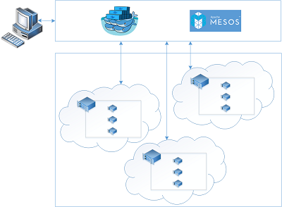
Azure Container Service
Create, configure, and manage a cluster of virtual machines that are preconfigured to run containerized application.
Layer | Supported Technologies
Configuration as Code | ARM, Dockerfile, Docker Compose, Marathon.json
Host cluster management | VM Scale Sets
Container orchestration | Docker Swarm, Chronos, Marathon, Apache Mesos
Monitoring | OMS, App Insights
Notes:
Key points:
Provide a framework for container tooling and ARM templates to work together.
Pluggable at every layer. We run Swarm and Mesos. Others could run other platforms.
Ties into the existing open source tooling and standards, so you can use tools that are already available.
Monitoring is also pluggable. Initially only OMS and App Insights.

Slide 11
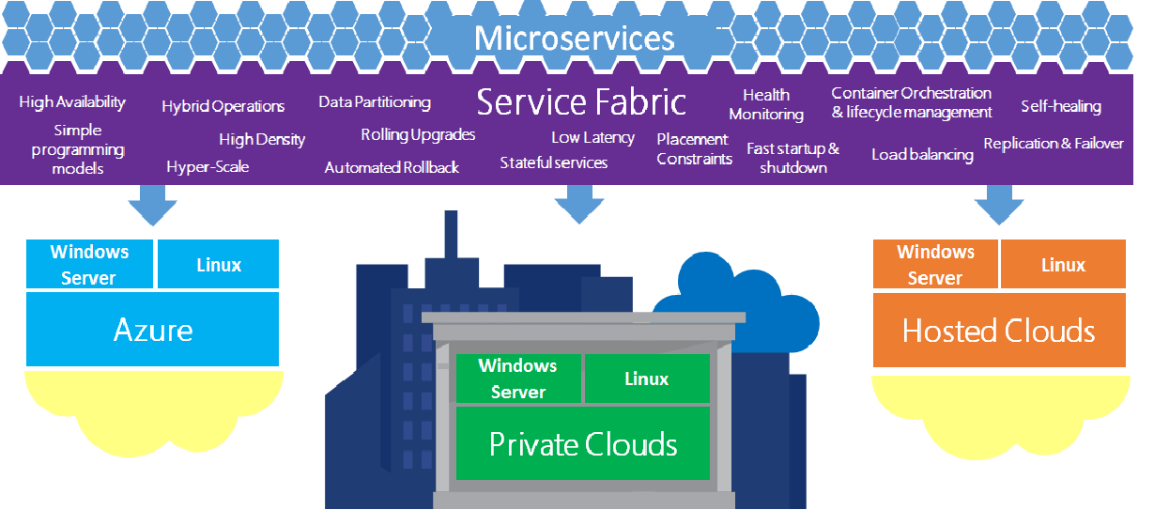
Service Fabric
Notes:
2:00

Slide 12
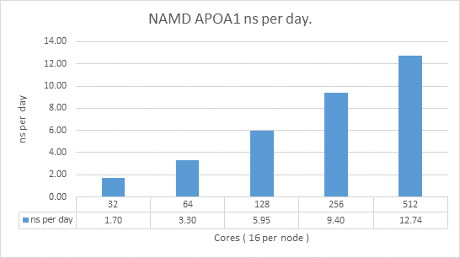
HPC Compute VM’s: A8-9 (A10-11)
Hardware designed for HPC
High CPU: 2x8 core processors per node, Sandybridge E-2670 at 2.6 GHz
High Memory: 128 GB, 1600MHz DDR3
Fast Interconnect: QDR InfiniBand for intra deployment traffic, 10gigE for standard Azure traffic and internet access
Scratch storage: 2 TB per node
Available in 8 core/56 GB and 16 core/112 GB instances
RDMA for Linux and Windows
Available in 7 regions
Bare Metal Equivalent Performance
~2.5-3.1 microsecond latency
>3GB/sec non blocking
90% efficiency on Linpack
Example: linear scaling on NAMD
Notes:
Non-blocking: have enough switch capacity such that we leverage full interconnect

Slide 13
Job Scheduler Agnostic
Commercial: Altair PBS, Univa Grid Engine, IBM LSF, Adaptive Computing Moab
Open Source: SLURM, SGE, Torque
Financial Services: Tibco Data Synapse, IBM Platform Symphony
Microsoft Hybrid: Microsoft HPC Pack (Windows and also now Linux)
Deploy via template (see our samples)
Connect network with VPN or Express Route
Scripts to scale up and down
Still need to stage data (think about Azure Data Factory)
Partner tools: Cycle Computing, UberCloud, Elastacluster, Altair, Rescale

Slide 14
Azure Batch: Job Scheduling as a Service
User application or service
Azure Batch
Cloud-enable applications, made available as SaaS:
Higher-level set of capabilities
Minimizes required Azure knowledge
App lifecycle, job dependencies, data movement, client plugins
Azure Batch
Foundational batch processing service
Don’t worry about the “plumbing”
VM management and job scheduling
VM management, job queue, and task dispatch
PaaS
Cloud Services
IaaS
Virtual Machines
Hardware
Notes:
With Azure Batch, you can forget about the infrastructure and the scheduling (you can “leave the plumbing to us”) and focus on your app or service instead. There are two models:
When you just leverage the foundational capabilities for VM provisioning and job/task scheduling. In this model, you enable the app and write the code to run it, to manage users, handle quotas, etc.
→This model is attractive to ISVs and SIs, especially if they already have their own SaaS portal. Could be attractive as well to organizations that have SaaS enable through their own platform already
If you want leverage the additional capabilities of Azure Batch around app, you can focus on your workload while Batch helps you with app lifecycle (add, update and retire apps), job dependencies and flow, moving data for jobs and tasks to use, adding and removing users and groups, assigning user roles, setting quotas and limits for users and groups, and plugging in directly into client apps
→This model is most attractive to organizations (small or large) that want to enable one or more apps as service quickly

Slide 15
What is Azure Storage
Storage account
Blob
Table
Queue
File
…
Shared 500 TB
Options for redundancy (LRS, GRS…)
Foundational Storage Services
APIs
Azure Services directly leveraging Storage
Virtual Machine VHDs
Azure Site Recovery
Backup
StorSimple
…

Slide 16
Azure Storage Offerings
Blobs
“Highly scalable, REST based cloud object store”
Block Blobs: Sequential file I/O
Page Blobs: Random-write pattern data
Tables
“Massive auto-scaling NoSQL store”
Dynamic scaling based on load
Scale to PBs of table data
Fast key/value lookups
Queues
“Reliable messaging at scale for cloud services”
Decouple and scale components
Message visibility timeout and update message to protect against unreliable dequeuers
Disks
“Persistent disks for Azure IaaS VMs”
Built on page blobs
Premium Storage Disks: SSD based, high IOPS, low latency
Files
“Fully Managed File Shares in the Cloud”
Map to file share, standard file system semantics
“Lift and shift” legacy apps
Code against (REST API)
Use on Windows & Linux VMs
Foundational building block of the Azure Cloud –Azure Data Lake, Azure SQL Data Warehouse, Azure HDInsight, OneDrive, Skype, Xbox,…
Hyper Scale: >80 trillion objects, >10 million transactions per second
REST based API, multi-platform, open sourced client libraries for many languages (e.g. Java, Python, Node.js, PHP, Ruby, Android, etc.)

Slide 17
Azure Storage Platform Capabilities
Scalability
Per account: 500TB of data , 20000 tps, 10Gbps ingress/20Gbps egress
Durability Options
Locally Redundant (LRS), Zone Redundant (ZRS), Geo-Redundant (GRS)
Read access from geo-secondary (RA-GRS)
Availability
99.9% for reads/writes, 99.99% for reads with RA-GRS. Backed by SLA.
Security
Symmetric shared key (AuthN)
Public (blob service only)
Azure Storage Service Encryption (SSE) for Data at Rest helps you protect and safeguard your data to meet your organizational security and compliance commitments.
Analytics
Rich perf-counter like metrics and detailed logs

Slide 18
Hierarchical/Tiered Cloud Storage
Product Lines
Object Blobs
Attached Disks
Cloud NAS
Files
Key/Value Tables
Reliable Queues
Future
Premium Disks
Future
Future
Future
Standard Blobs
Standard Disks
Standard Files
Standard Tables
Standard
Queues
Services offered at different temperatures to match workload
Temperature
Cool Storage
Future
Vision: Automatic data tiering based on customer defined policies
Archival Storage
Future
Notes:
>50TPS/TB = Hot
>3TPS/TB = Warm
where cool is <5 seconds, and cold is <24 hours
Competitive offering, most comprehensive set of offerings

Slide 19
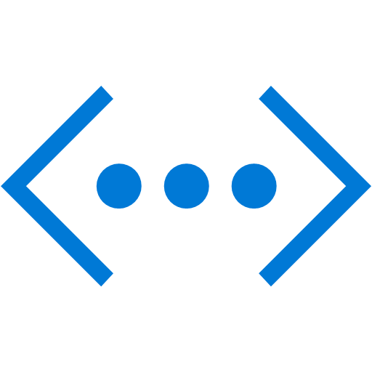
The Big (Network) Picture
Virtual Network
“Bring Your Own Network”
Segment with subnets and Network Security Groups
Control traffic flow with User Defined Routes
Azure
Virtual Network
Users
Internet
Front-End Access
Dynamic/Reserved Public IP addresses
Direct VM access, ACLs for security
Load balancing
DNS services: hosting, traffic management
DDoS protection
Backend Connectivity
Point-to-site for dev / test
VPN Gateways for secure site-to-site connectivity
ExpressRoute for private enterprise grade connectivity
Backend Connectivity
ExpressRoute
VPN Gateways

Slide 20
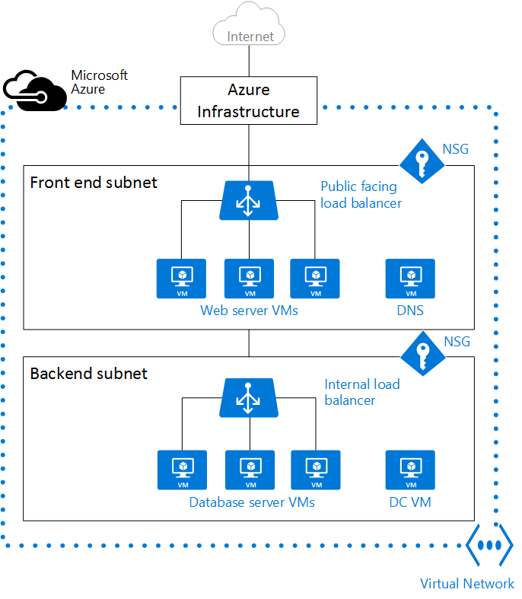
Azure Virtual Network (VNet)
An Azure virtual network (VNet) is a representation of your own network in the cloud. It is a logical isolation of the Azure cloud dedicated to your subscription. You can fully control the IP address blocks, DNS settings, security policies, and route tables within this network.
Cannot have overlapping IP ranges on-prem / Azure / other cloud providers. Leave Room for Future Growth – can always add Subnets and VNETs

Slide 21
Network Security Options
Network security group (NSG) contains a list of Access Control List (ACL) rules that allow or deny network traffic to your VM instances in a Virtual Network. Sample NSG Rules -
No access from the front end or back end to the Internet.
Access to port 3389 to any web server in the front end, for traffic coming from the front end subnet itself.
Access to port 3389, 1433 to all SQL Server VMs in the back end from the front end subnet only.
Separation of management traffic (port 3389) and DB traffic (1433) on different NICs in the back end VMs.
A virtual appliance is just another VM in your VNet that runs a software based appliance function, such as firewall, WAN optimization, or intrusion detection. You can create a route in Azure to route your VNet traffic through a virtual appliance to use its capabilities. NSGs provide layer 4 Access Control List (ACL) to incoming and outgoing packets. If you want to use a layer 7 security model, you can use a firewall appliance.

Slide 22
Load Balancer Hierarchy
Azure Service | What | Example
Traffic Manager | Cross-region redirection & availability | http://news.com ➔ apac.news.com ➔ emea.news.com ➔ us.news.com
Azure Load Balancer | In-region scalability & availability | emea.news.com AppGw1 AppGw2 AppGw2
Azure Application Gateway | URL/content-based routing & load balancing | news.com/topnews news.com/sports news.com/images
VMs | Web Servers
Internet
Azure Traffic Manager (DNS Load Balancer)
SLB (L4 Load Balancer)
SLB (L4 Load Balancer)
Application
Gateway
Application
Gateway
Application
Gateway
Application
Gateway
VM
VM
VM
VM
VM
VM
VM
VM
Region 1
Region 2

Slide 23



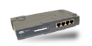


Site-to-Site VPN Connections
IPsec VPN over Internet
Each VNet requires S-S VPN to connect to on-premises
Each VNet uses a GatewaySubnet
Microsoft Azure
On-premises Network
Storage
SQL DB
Websites
IT
Proxy /
Internet edge
SQL Farm
IIS Servers
AD / DNS
AD / DNS
Monitoring
Sales
Exchange
R&D
AD / DNS
Marketing
AD / DNS
AD / DNS

Slide 24
ExpressRoute Connections
Private connections between Azure datacenters and infrastructure on your premises or in a colocation environment. Provides lower latency, higher bandwidth and greater availability.
Share an ExpressRoute circuit
across subscriptions (up to 10)
Microsoft Azure
On-premises Network
Storage
SQL DB
Websites
IT
Proxy /
Internet edge
SQL Farm
IIS Servers
AD / DNS
ExpressRoute
AD / DNS
Monitoring
Sales
Exchange
R&D
AD / DNS
Marketing
AD / DNS
AD / DNS

Slide 25
VPN Gateway Options
Azure VPN Gateway
Fault-tolerant Routing & remote access service. Basic, Standard, & High Performance SKU’s
100-200Mbps throughput for VPN Gateway Type and 500-2000Mbps throughput for ExpressRoute Gateway Type
Static (Policy-based, 1 Tunnel) or RouteBased (Dynamic routing, multiple tunnels) available
3rd Party Appliances
Vendor-certified appliances acquired through Azure Marketplace (Cisco, Barracuda, Checkpoint, Juniper etc)
Often provide features beyond IPSec VPN tunneling. Build to vendor’s recommendations to support throughput/workloads
Use UDRs & NSGs to force traffic through appliance(s) for analysis/control

Slide 26
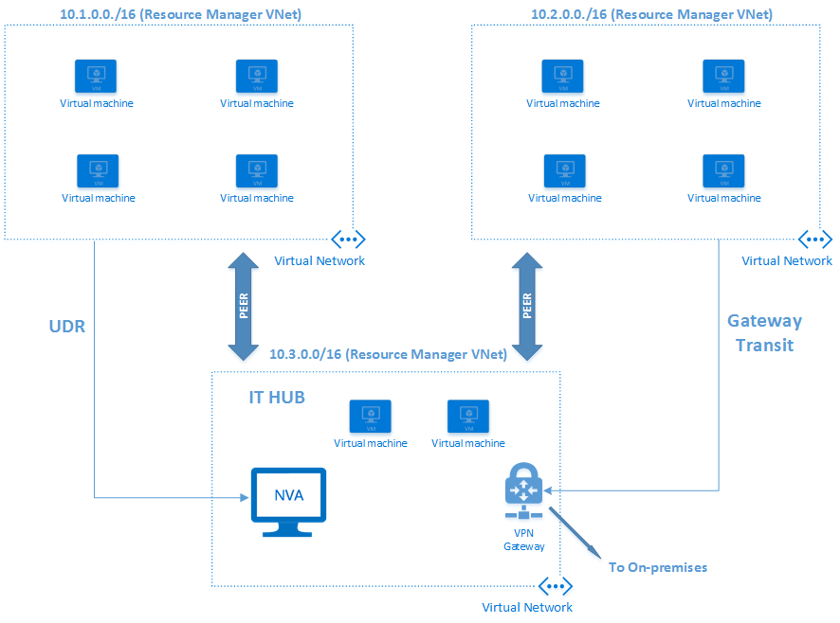
Hub Spoke Model

Slide 27
CA DOE CALPADS Architecture

Slide 28
Demo
Storage Explorer
Secured Network
Highly Available VMs

